Slide 1
Notes:
If your parents would like to see the presentation in Spanish, please go to the HAIS website – Click on “About Us”, Faculty, scroll down and click on Sherman, scroll down to “Parent Corner”, download the presentation, join the meeting translated in Spanish.

Slide 2
Dual Credit Parent Orientation
Welcome Parents
Class 2025
Please sign in!
https://tinyurl.com/Jan13DualCredit
Notes:
Welcome to our Dual Credit Parent Meeting. Please sign in for attendance using this QR code. If you are unable to access the code, we will be able to take attendance through MS TEAMS.

Slide 3
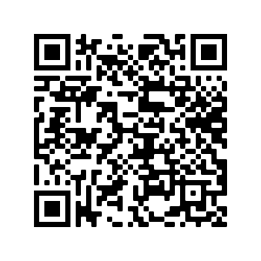
For Best Meeting Reception
Scan Me
Meeting is recorded
Turn-off camera & microphone for best reception
Recording + Transcript will be posted to HAIS website in English and Spanish
Questions after the meeting? … go here https://tinyurl.com/POFI1301-Questions
Notes:
Please reach out to me through the following tools if you have questions after the meeting that I have not answered. I will publish the Q & A to you in a Naviance email.

Slide 4
Notes:
I want to thank you for taking time out of your very busy schedule to join us tonight. We recognize you have many option for HS within HISD. We thank you for choosing HAIS and giving us the privilege of educating you child. We take this responsibility very seriously.

Slide 5
Agenda
Objectives of the course
How can parents find important information?
Grades
Syllabus
Grading of the course
Major test dates
Title I – Jwilli56@houstonisd.org
How can parents support students?
Q & A
Assignments
Homework policy
Extra Credit
HCC Policy
Tutoring
Notes:
We will be going over the following topics tonight. This meeting is being recorded and will be posted to the HAIS website.

Slide 6
Title I – jwilli56@houstonisd.org
Please sign in. https://tinyurl.com/Jan13DualCredit
All documents and videos from previous presentations can be found on our website.
https://www.houstonisd.org/domain/47239
You can access a video about Title I on the website above
If you have any questions or concerns about our Title I status, please contact me via email at jwilli56@houstonisd.org and I will be happy to answer your questions.
Notes:
Information about Title I and all the benefits to parents and students can be found at the following locations.

Slide 7
REASON We’re here …
To support the success of your student!
Notes:
The REASON we are here is to support student success. Your teen needs you now more than any other time in their lives. We want them to become Self-Advocates, and you stay involved in their lives.

Slide 8
HAIS will …
prepare students for active roles as global citizens
Notes:
At HAIS, a portion of every class focuses on preparing your students to become active members of the global community. The 9th Grade Planning Team coordinates projects with global objectives across all subjects.

Slide 9
POFI1341 will …
Notes:
5 main objectives of this course: 1.) serve as a transition between HS and College 2.) become responsible global citizens 3.) apply learned computer application skills to address emerging technology 4.) learn software skills to secure a good future 5. ) strengthen marketability in the workforce through earning Microsoft Certifications

Slide 10
86% C +
94% Pass
97% MOS
All HAIS students have taken this course (over 2,000)
Notes:
You may be saying to yourself “those are aggressive goals”. I want to reassure you your students are intelligent, creative, delightful individuals who are fully capable of reaching these goals. I have been teaching this class for over 10 years and the students are EXTREMELY successful.

Slide 11
Where to find information?
Notes:
Now, we will cover where parents can find information

Slide 12
Syllabus
Binding contract between professor and student
Contains:
Grading scale
Assignments
Test dates
Classroom policy
HCC’s Policies for
Record Privacy
Accommodations
Plagiarism
Notes:
The course Syllabus should be your 1st source to go to for answering questions. It is located on the HCC website. Open to the public. You do not need an account. Sherman to give demonstration of how to find Syllabus.

Slide 13
Syllabus
Learning Web @ hccs.edu
Grades
Canvas student must access
Tests dates
Syllabus
Assignments
Syllabus
Updated every 2 weeks
Canvas
Canvas
Canvas
Hardcopy every 3 weeks
Parent Access to Information
Notes:
Here is a list of where to find frequently requested information. You will note most are in the Syllabus. Syllabus are required to be posted 7 days after classes start. The Dean of the Business Technology Dept. writes the Syllabus for this class. The latest version for this course will be posted by Friday of next week.

Slide 14
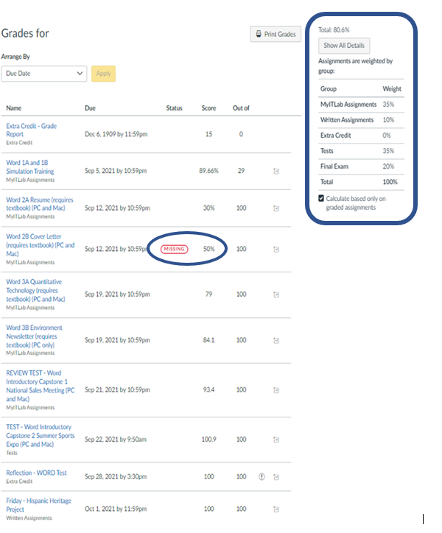
How Are Grades Calculated?
Grades have different weights based on the assignment type
Sherman conferences with every student at least once every 3 weeks discussing:
Grade setting goals
Glows and grows
Challenges / obstacles
Action plans to overcome
Students receive hard copy of grades every 3 weeks.
Extra credit for returning grades and action plan signed by parents
Missing assignments = 50 pts to not excessively impact student
Notes:
Here is an example of what the Canvas grades look like. Most important assignments are weighted higher than others. Students receive a 50 on missing homework assignments because zeros (0) drag down their grade too much. Individual student conferences held every 3 weeks. Model how to analyze their grades and identify what actions they need to take to receive the grades they want.

Slide 15
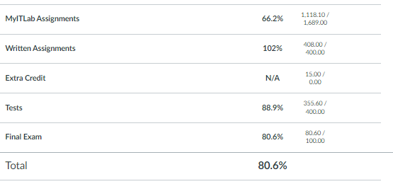
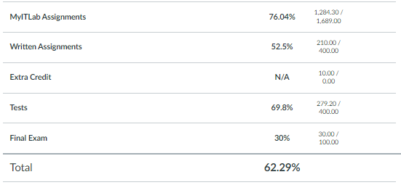
Does Homework Impacts Grades? Y E S
Missing homework lowered grade
No Extra Credit
Did great on test
Would have received an ‘A’ … IF
Turned homework in on-time
Do extra credit
HCC Grading Formula
A = 100 – 90
B = 89 – 80
C = 79 – 70
D = 69 – 60
F = 59 and below
Homework saved grade
In-class assignments. No reason not completed.
Difference between passing vs FAILING
Student passed ONLY because homework turned in on-time
Notes:
Here are two examples of how homework impacted a student’s grades. Note grading scale for HCC is different than HISD. Take this into account when discussing expectations with your student.

Slide 16
In addition to …
not instead of
UIL
Saturdays, 6:45 AM thru 4:00 PM ---(bus from HAIS provided)
January 22, 2022--Waltrip HS
February 19, 2022--Sterling Aviation HS
March 26, 2022--Westbury HS
UIL Event Team Leader
Demonstrate skill of the day
Peer Tutor
Create engaging educational activities
Create class informational publications
Teacher Assistant
Suggest idea to Sherman
It’s a Savings Account … earn it BEFORE
you need it!
Notes:
Please remember at the end of the day, students must do the work. Extra credit is meant to add a little boost, not replace whole assignments. There will not be many extra credit opportunities this semester as college classes do not normally offer extra credit. They need to take advantage of the opportunities when offered

Slide 18
Student Resources
Class recorded videos
“How-to” videos by chapter
E-textbook
PowerPoint notes by chapter w/ screenshots
Audio PowerPoint Presentations
Practice Simulations
Accessibility Enhanced Simulations
Step-by-Step Instructions
Calendar of Assignments for entire semester
Immediate feedback on grades
Work assignment multiple time for best-grade until due date
Extra Credit opportunities
Notes:
Students have an abundance of resources available 24/7. Major differences between HS vs College = college it is the student’s responsibility to learn. My main job is to teach them how to “learn how to learn”. They start the learning process using the resources and plan provided. The professor is a mentor/facilitator. I ask them open ended questions so they can lead themselves to the answer.

Slide 19
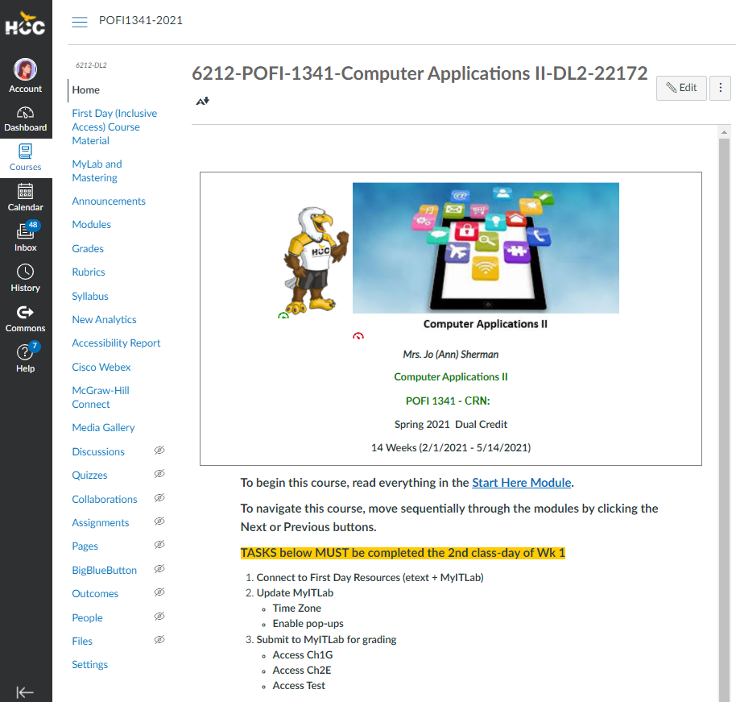
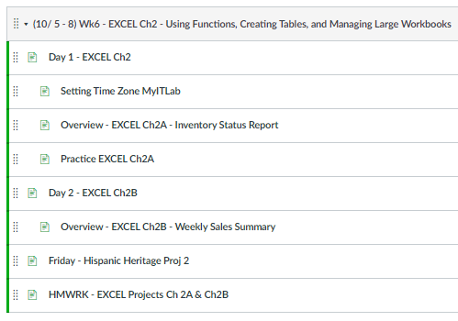
Example of Weekly Module
Weekly Instructions
Notes:
Here is what the Canvas website looks like. Note: weekly instructions are under Modules.

Slide 20
hccs.upswing.io
Scan Me
Notes:
HCC offers online tutoring

Slide 21
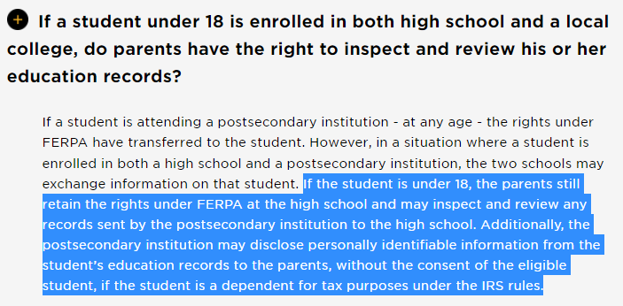
Please complete a FERPA Form at HCC
Notes:
Please complete the FERPA form through HCC so that all the documentation of who can see student private information has been fulfilled.

Slide 22
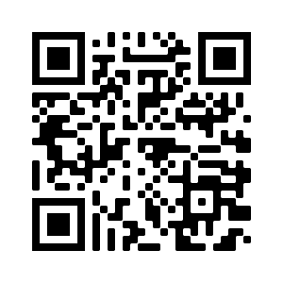
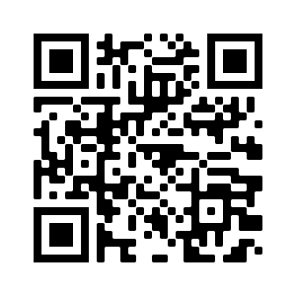
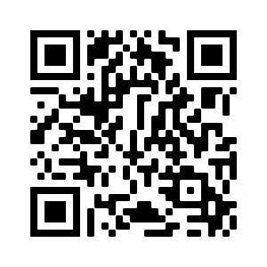
On Campus FERPA
Online FERPA
Upload FERPA
Notes:
Here are the links to the FERPA forms you will need. The entire process can be done online.

Slide 23
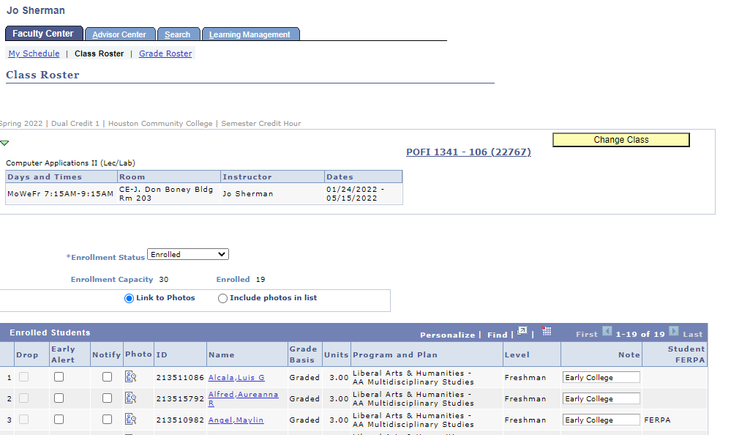
Notes:
This is what I see when FERPA forms are completed

Slide 24
Parent Involvement
Cheer leader
Encourage studying daily
Provide quiet learning space
Check grades weekly
Notes:
You play a very important role in your student’s life. They need your leadership at this point in their life more than ever. I only see your child 3 hours and 45 minutes per week. YOU are the biggest influencer.

Slide 25
OFFICE HOURS
Daily: 7:20 – 7:45 AM HAIS courtyard
During Class: M/W/F or T/TH/F
WRITTEN COMMUNICATION
CANVAS INBOX
HCC EMAIL
* HCC Policy states students must communicate through an HCC System using their HCC Student ID #
Students …
COMMUNICATE!!
We’re Here to Help you
Notes:
We are here to help your student to become a self advocate. They need to communicate with us when they are having issues so we can help. We’re a team!

Slide 26
Parent Handbook
Dual Credit
Dual Credit FAQs
Parent Academy
Parent Academy Video
FERPA
Parent Resources
Notes:
Here are links to important information

Slide 31
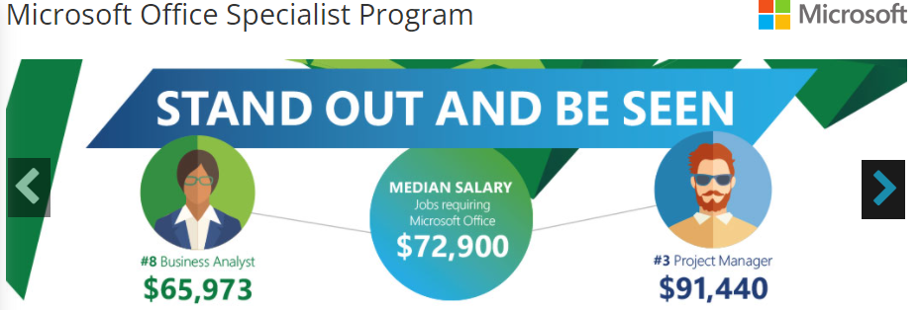

Slide 33
Credits
North Texas Performing Arts.Org
www2.ed.gov › ferpa
Sacha-keeper.com
Consumerenergyalliance.com
Uh.edu/mascot
Challengethecode.com

